Slide 1

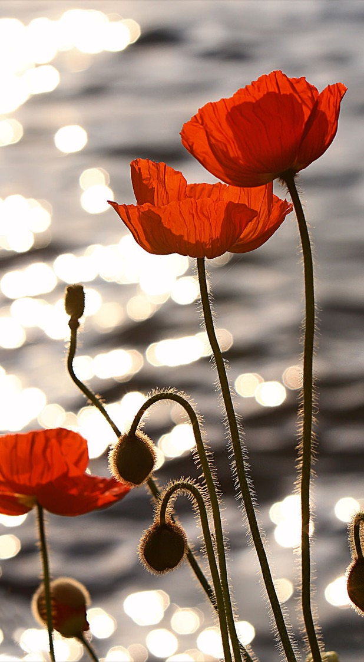
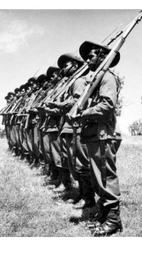
ANZAC DAY
2020
Remembering our Indigenous and Non-Indigenous Servicemen and Women
Lest We Forget

Slide 2
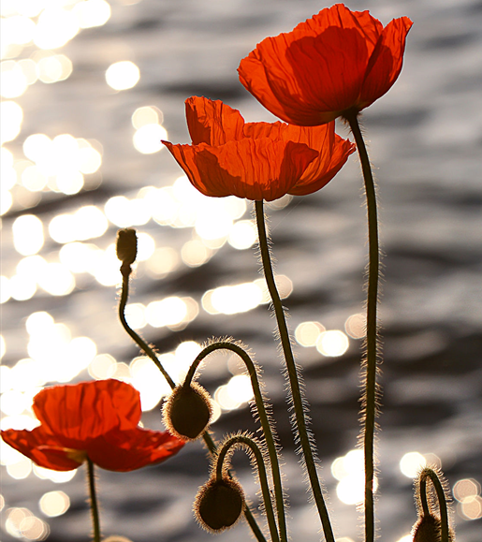
We acknowledge the traditional custodians of this land and pay our respects to the elders both past, present and future for they hold the memories, the traditions, the culture and hope of their people.
WARNING: Aboriginal and Torres Strait Islander people are advised that the following contains images and voices of deceased persons

Slide 3
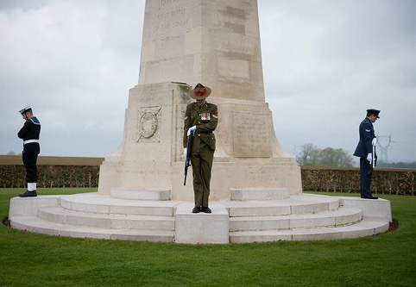
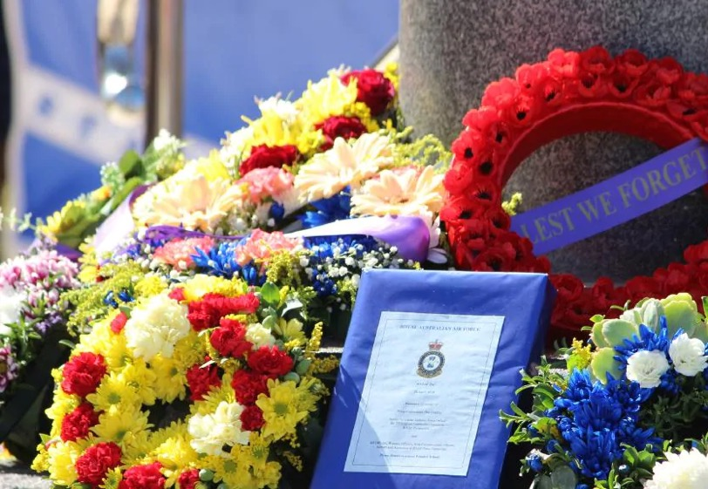
Our Anzac History
Since 1916, Australians have proudly celebrated ANZAC day held each year on 25 April. This date marks the anniversary of the first military action fought by Australia and New Zealand, at Gallipoli (Turkey) during World War 1 in 1915.
Over the years, the rituals and observances held each ANZAC day have developed into what they are today – including the dawn service, marches, memorials and more. The day has also become a commemoration of all wars Australia has participated in and a time to reflect on war and its legacy.
As Australians, we take immense pride in honoring our servicemen and women who so bravely have and continue to, serve our country.
Script Courtesy of ‘Deadly Story’ https://www.deadlystory.com/page/culture/articles/anzac-day-2018
This Photo by Unknown Author is licensed under CC BY

Slide 4
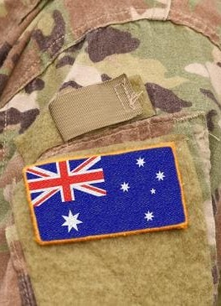
Our Brave Australians
Australian’s are proud of our brave ‘diggers’ and those who have and continue to serve our country so selflessly. The notion of ‘mateship’ runs strong on Anzac day and has done for over 100 years.
Sadly, after huge sacrifice was made by thousands of indigenous soldiers in past world wars, many Aboriginal and Torres Strait Islanders returned to a country that continued to deny them even basic rights. Their contribution to service was quickly forgotten.
Educating ourselves about their injustices is a way to honour and pay respect to our remarkable indigenous servicemen and women.
This presentation aims to acknowledge the tremendous contribution of indigenous servicemen and women in Australia’s history and to celebrate the past and continued contribution of ALL serving Australians.

Slide 5
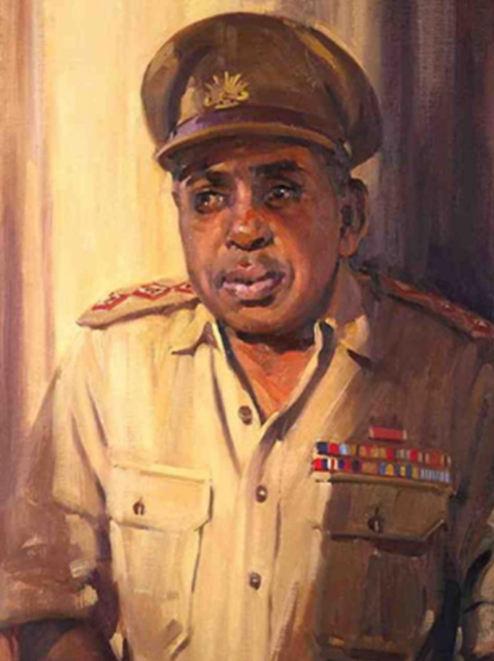
Background of our Aboriginal and Torres Strait Islander Servicemen and Women
Australian Service throughout History
Up to 16 000 Australians served in the Boer War (1899-1902) including 50 Aboriginal and Torres Strait Islander people.
416 809 Australians enlisted in World War l (1914-1918) including 1000 Aboriginal and Torres Strait Islander people.
Nearly one million Australians served in World War ll (1939-1945). Of these, at least 3850 were Aboriginal and Torres Strait Islander people
In both World Wars, Aboriginal and Torres Strait Islander people had the highest participation rates in the military as a proportion of their population in Australia
Aboriginal and Torres Strait Islander people have participated in all military conflicts since the World Wars, including in Vietnam, Iraq and Afghanistan and in peacekeeping operations including in Somalia and East Timor
In 2011 Aboriginal and Torres Strait Islander people made up 1.7% of the Australian Army.
Reginald Walter Saunders was the first Aboriginal to be commissioned as an officer.
Script courtesy of Australian War memorial https://www.awm.gov.au/articles/second-world-war

Slide 6
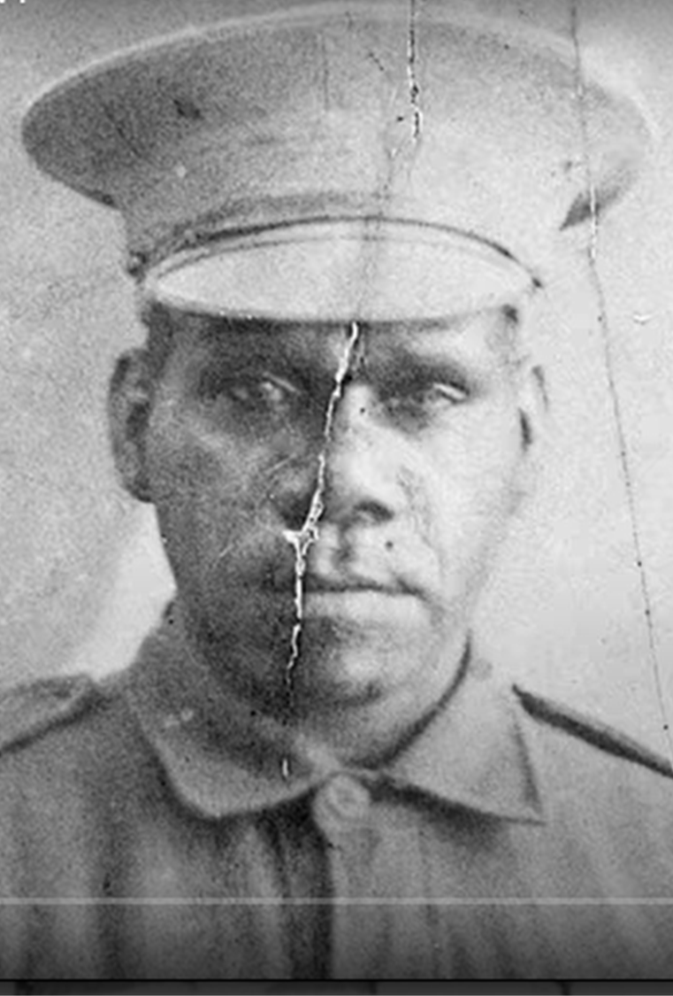
Historical Reasons for Indigenous Persons going to War
In Australia’s past, a strong motivator for indigenous men and women was the promise of fair treatment and equality whilst in the armed forces. Aboriginal and Torres Strait Islander people faced racism, colonisation and discrimination on a daily basis in Australia. However, once in the armed forces, Aboriginal and Torres Strait Islander people were often treated the same as their non-Indigenous counterparts, lived in the same conditions and were paid the same amount.
While racism still existed in the armed forces, many Aboriginal and Torres Strait Islander soldiers have said they were treated better while in the military. In World War II, many Aboriginal and Torres Strait Islander service people were also promised full citizenship rights on their return.
Aboriginal and Torres Strait Islander people were also offered higher pay and better employment and education opportunities in the armed forces than in Australia. War also offered a sense of adventure and a chance to see the world.
‘”There was no discrimination because we quickly realised that the enemy bullet doesn’t discriminate, so we’d look after each other. Colour didn’t matter.”

Slide 7
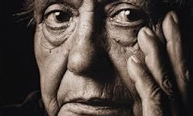
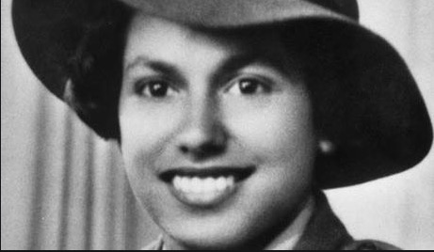
On the Battlefield and Home Front
Oodgeroo Noonuccal was an aboriginal war veteran, rights activist, poet, environmentalist and educator. When the Second World War broke out in 1939 two of her brothers, Eric and Eddie, enlisted for service in the army. Both were captured by the Japanese when Singapore fell in February 1942, and they spent the next three and a half years as prisoners of war.
In December 1942 Oodgeroo joined the Australian Women’s Army Service (AWAS) and trained as a signaller. Oodgeroo remained in the AWAS until early January 1944.
"I joined the (Australian Women’s Army Service in World War II because) …it was also a good opportunity for an Aboriginal to further their education. In fact there were only two places where an Aboriginal could get an education, in jail or the Army and I didn’t fancy jail!" - Oodgeroo Noonuccal
Script courtesy of Australian War Memorial https://www.awm.gov.au/learn/memorial-boxes/3/online-resources/walker

Slide 8
Promises of Change not Kept
After returning from war, having fought for their country and experienced equal treatment during their service, Aboriginal and Torres Strait Islander people found the same, and in some cases, worse discrimination, colonisation and injustice as when they’d left. Not only that, many Aboriginal and Torres Strait Islander service people were not respected as veterans and did not have their contributions recognised.
One example of this happened after the Boer War, when Aboriginal men who had participated are believed to have been denied entry back home due to the immigration restrictions of the White Australia Policy.
After the World Wars, Aboriginal veterans received little public recognition or support. They were denied access to schemes that provided returning soldiers with land and job opportunities. For example, the Soldier Settlement Scheme aimed to give land and work to returning soldiers. This involved splitting up large rural estates into smaller farming blocks and leasing them to returned service-people. However Aboriginal soldiers were denied access to this scheme. In some cases Aboriginal land was divided under this scheme and then was granted to non-Aboriginal soldiers. Communities are still fighting to have this redressed.

Slide 9
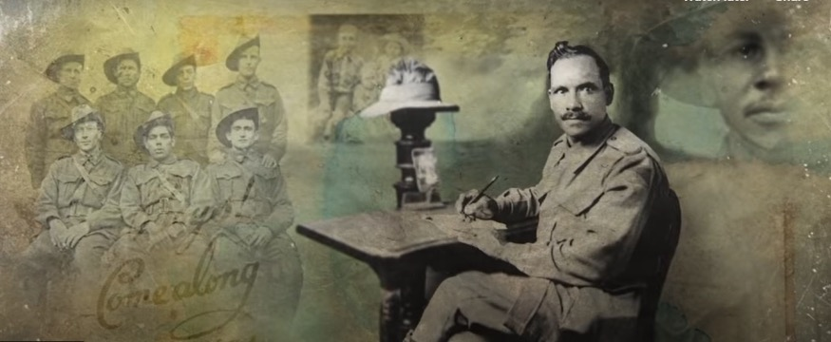

Click on the above image to watch a clip detailing the plight of Indigenous Service Men and Women to enlist.

Slide 10
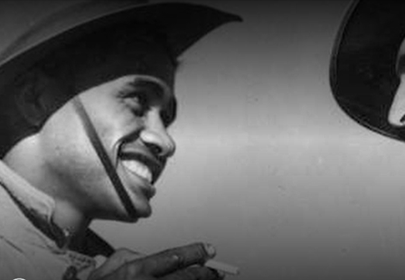
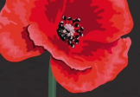


Moving Forward
Today, we as a nation proudly recognise and celebrate the contribution of all indigenous and non-indigenous servicemen and women to our country.
The staff, students and families of St Columba’s Primary School honour the service and sacrifice of our original ANZACs, and the generations of Australian servicemen and women who have defended our values and freedoms, in wars, conflicts and peace operations.
Watch the below clip featuring some well-known Australian artists honouring our Australian servicemen and women through a very moving song.

Slide 11
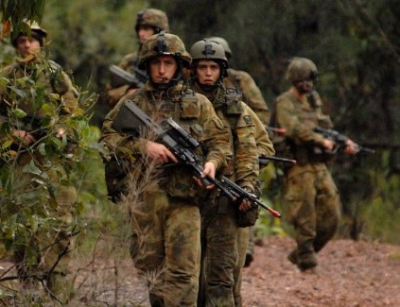
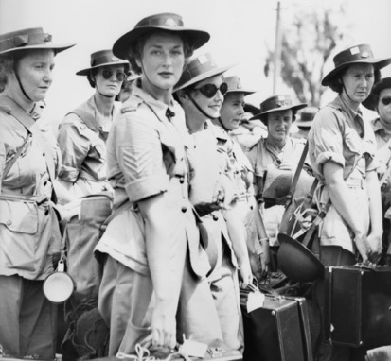
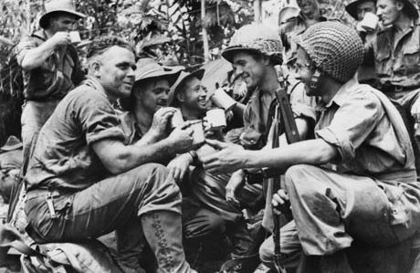
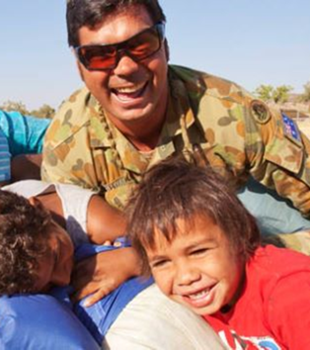
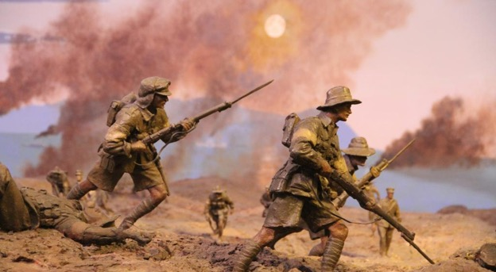
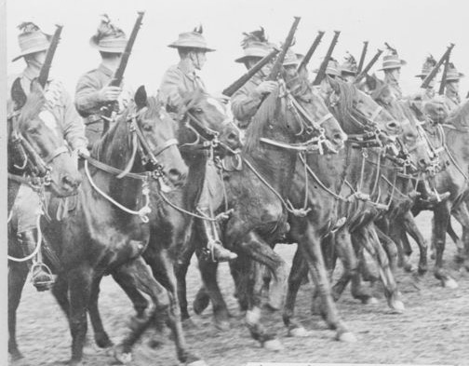
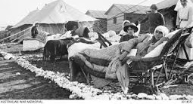
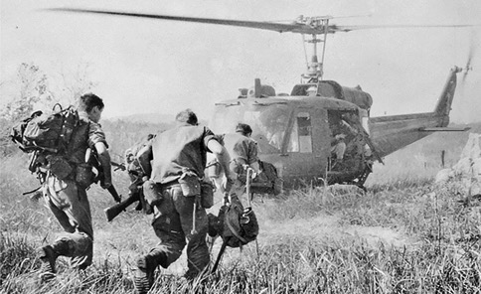
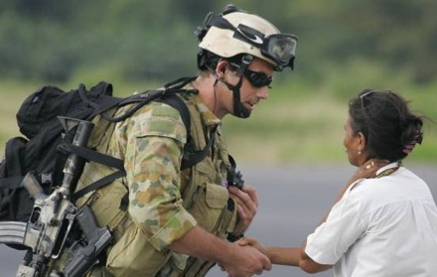

Slide 12
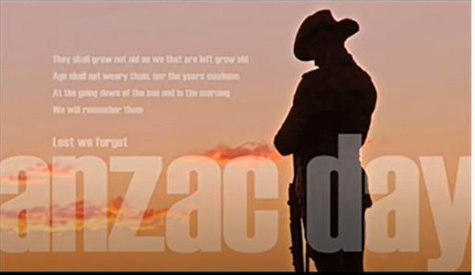
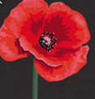

Click on the above Anzac Day image to listen to
‘The Last Post’

Slide 13
Acknowledgements
Naccho Aboriginal Health News Alerts
The Anzac Centenary national program
Australian Peacekeepers https://www.thinglink.com/scene/529869198633992192
Deadly Story https://www.deadlystory.com/page/culture/articles/anzac-day-2018
Bush Tv: Untold Stories WW1 https://www.deadlystory.com/page/culture/articles/anzac-day-2018
Let’s Talk: Reconciliation Australia https://www.reconciliation.org.au/wp-content/uploads/2017/11/Lets-talkRemembering-the-forgotten-Anzacs.pdf
Australian War Memorial https://www.awm.gov.au/learn/memorial-boxes/3/online-resources/walker
Presentation By: Danielle Shaw
Aboriginal and Torres Strait Island Teacher
St Columba’s Primary School, Adamstown.
danielle.shaw@mn.catholic.edu.au
https://nacchocommunique.com/tag/world-war-ii/
https://anzacportal.dva.gov.au/commemoration/commemoration-days/national-program/anzac-centenary

